Slide 1
YOUniverse
A multi-dimensional roguelike fighting game,
where YOU are your greatest enemy
The Dingo Devs Present
Notes:
Kenzie

Slide 2
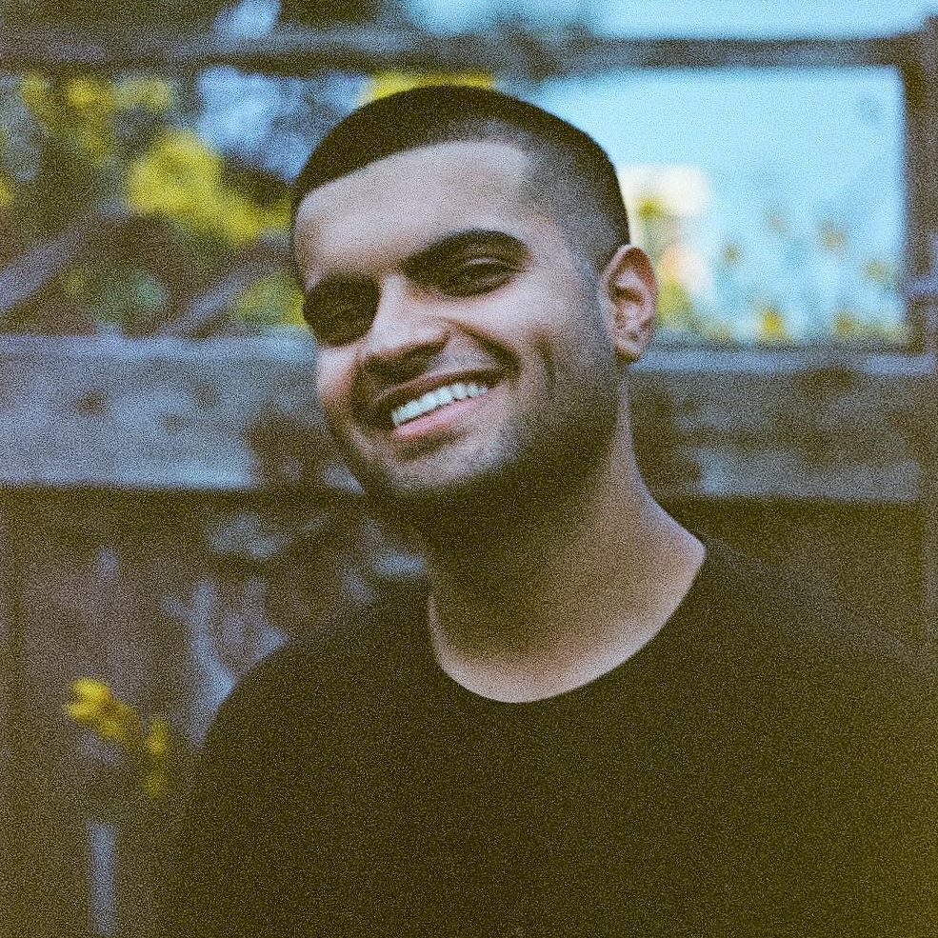
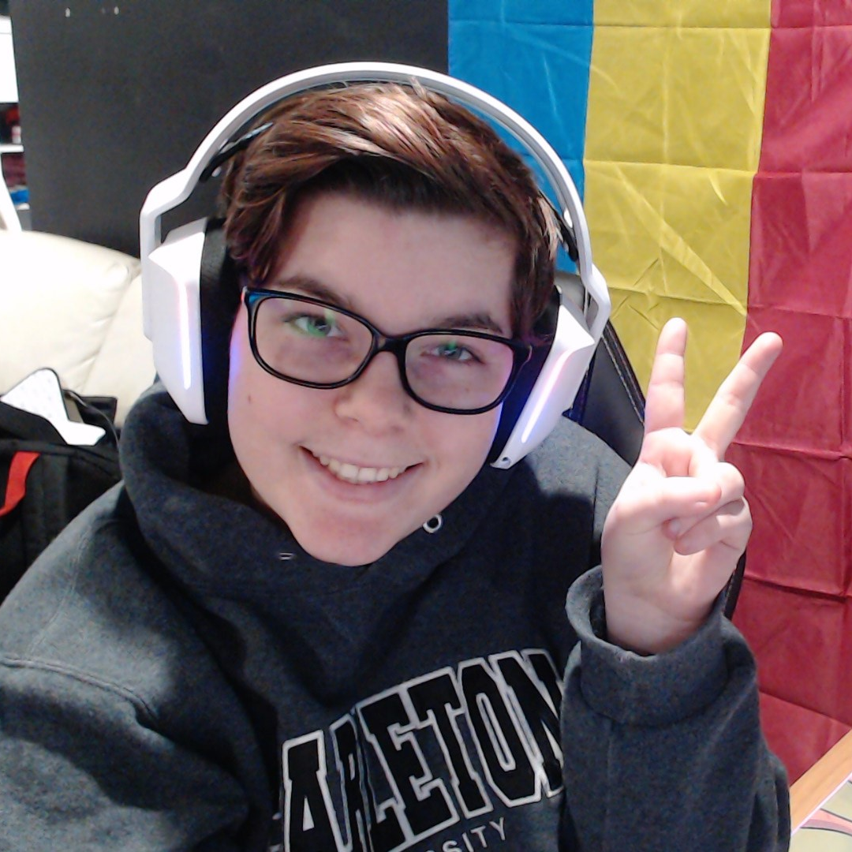
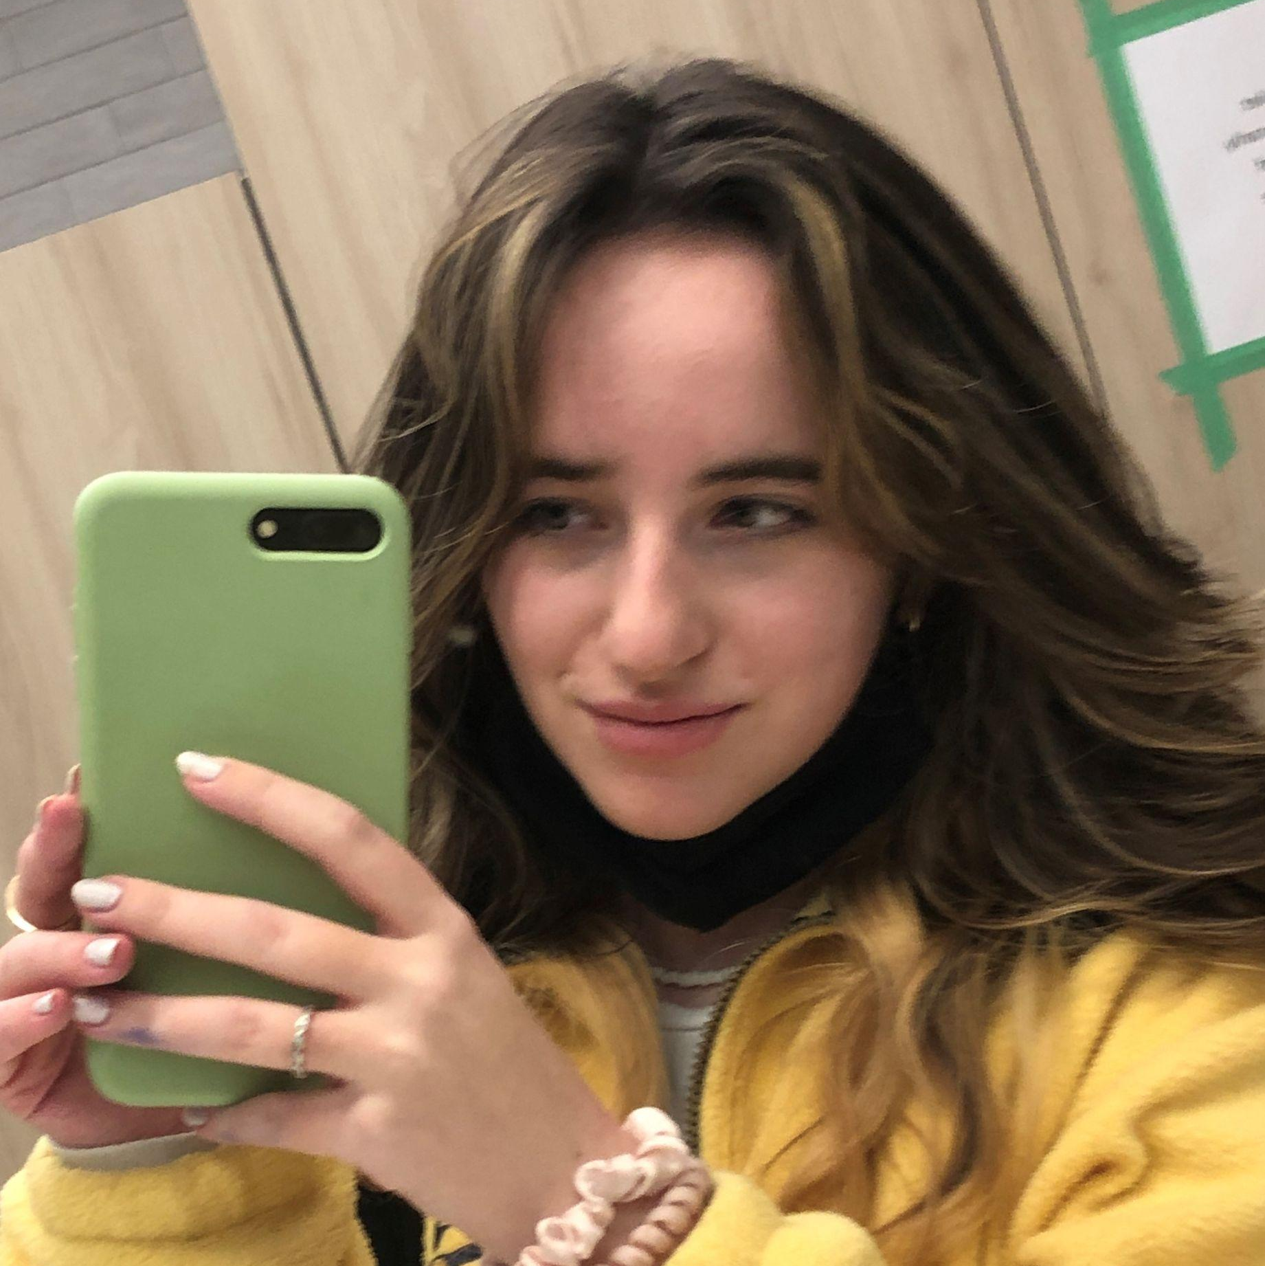
Our Team!
Adel Manji Sound Design & Music
I like taking pictures and watching YouTube
Marcus Santos Lead Programmer/Head Chef
I like playing video games with my friends :)
Mackenzie Darling Head Artist
I like dogs, drawing, and D&D
Danielle Cole Lead Designer
I like collecting stickers then never putting them anywhere
Notes:
All

Slide 3
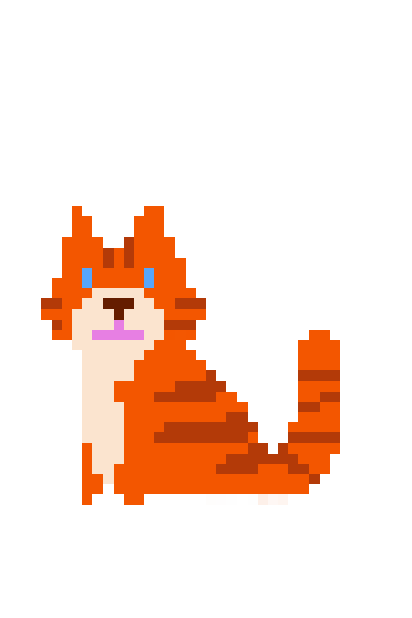
THE STORY SO FAR…
As a university student named Max, life sucks. Classes are boring AF and you don’t have many friends other than your cat, Meowbert. Until one day, your science experiment goes wrong and opens a portal to a million parallel dimensions!
With a froosh, your beloved cat gets sucked into the multiverse. In a desperate attempt to get him back by hopping dimensions, you soon discover every other version of you wants you dead.
Will you prevail over top of your better halves or will you kill... you? Wait, who’s who again? God, I miss Meowbert…
Notes:
Context (Dani)

Slide 4
As you travel the multiverse..
Explore
Walk around levels to explore your surroundings and talk to NPCs
Fight Boss Battles
Each world has a main boss fight at the end.
Collect Power-ups
After each fight, your character levels up with a new power/weapon.
Advance the Story
Advance the plot to reclaim your cat
Notes:
Dani (Dynamics)

Slide 5
Some of the dimensions you might travel…
The Origin Dimension
Gym Dimension
Future Dimension
1
3
5
2
4
6
Rockstar Dimension
Detective Dimension
Office Dimension
Notes:
Adel

Slide 6
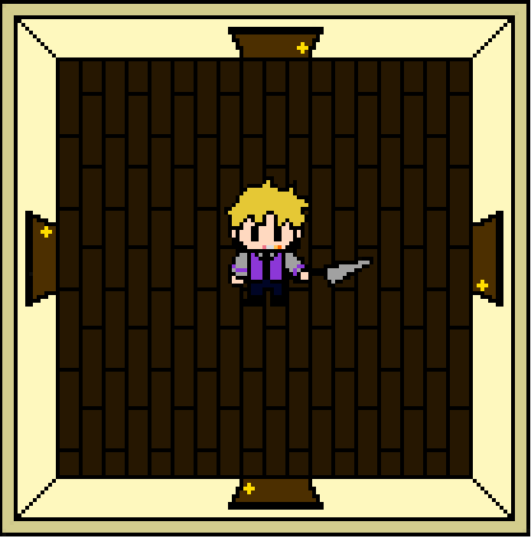
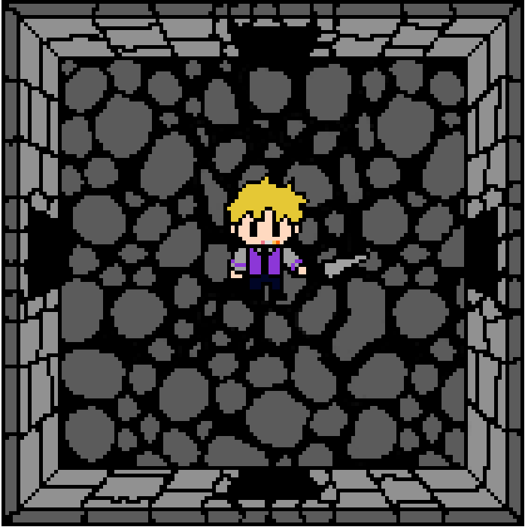
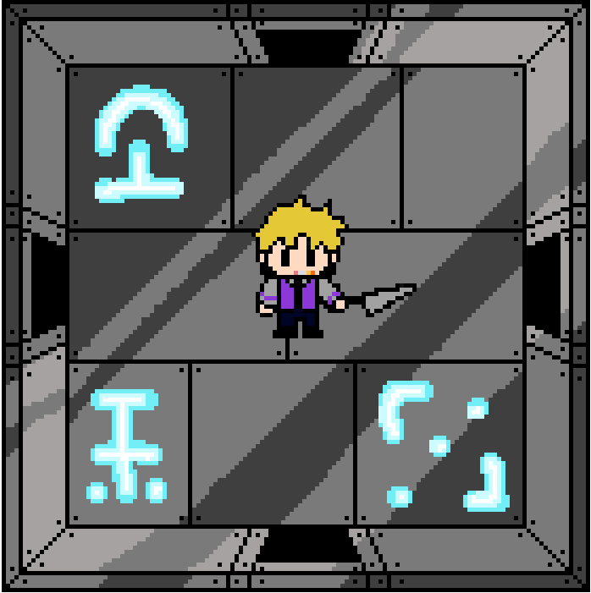
Art Samples
Notes:
Kenzie

Slide 7
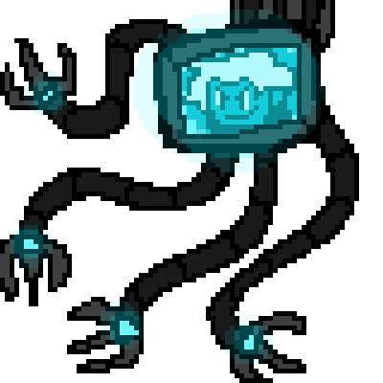
Notes:
Kenzie

Slide 8
Intended Effects
We want this game to make you laugh, but we also want to break you mentally.
Notes:
Intended Effects (Marcus)

Slide 9
Intended Effects
Humor
The player will experience a variety of nonsensical interactions with weird and humorous characters.
Challenge
We want the game to be challenging while also being rewarding and fair so players are motivated to continue.
Notes:
Marcus, Adel

Slide 10
THANKS!
Any questions?
Notes:
Dani

